Slide 2
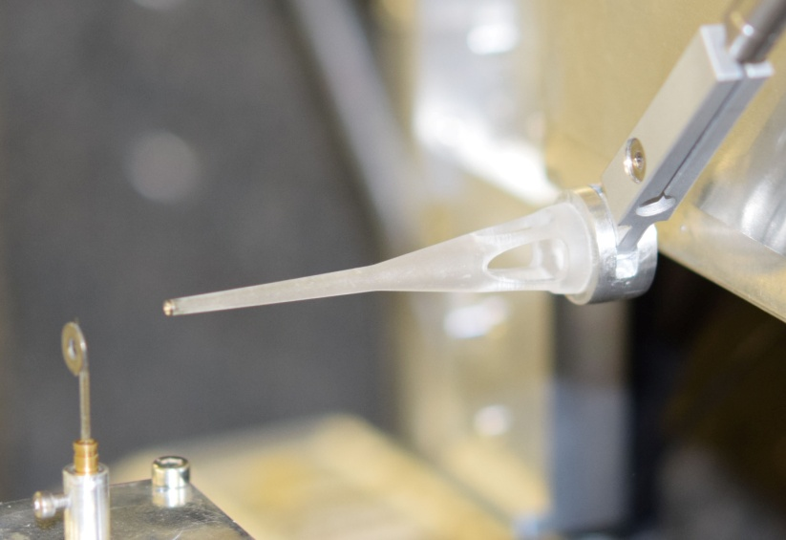
overview
Introduction
Design of the cryo sample stage for nano scanning
Cooldown test results
Beamline test results
Future development: sample changer
Conclusion
Bonus development:
3D printed pinhole support Martin Rosenthal, ID13

Slide 3
Introduction
We want to investigate material properties at the nano scale: architecture, distribution of atomic species, crystal structure
Nano scanning capabilities: most often a complete endstation
Bionanoprobe @APS, Kotobuki-1@Spring-8, ID16A @ESRF
Biological samples:
Data acquisition is limited by radiation damage
Cryoprotection is necessary
With higher beam intensity → fast detection to outrun the radiation damage + added advantage to scan faster than the temperature drift

Slide 4
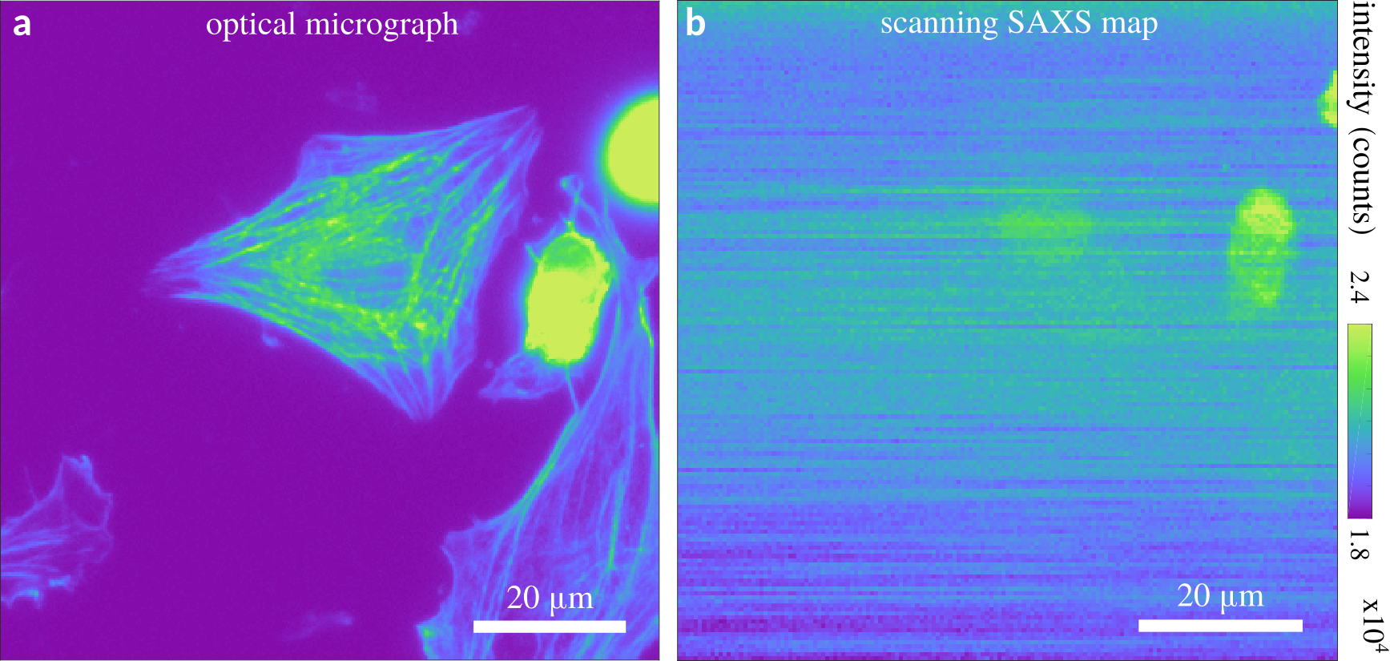
Example
Partnership University of Göttingen / PSCM
Jan‐David Nicolas - Scanning x‐ray diffraction and coherent imaging of soft biological samples
Oral presentation Wednesday microsymposium UDM2
X‐ray microscopy in biology: recent applications,
challenges and opportunities
Scanning SAXS at cryogenic temperatures. Left: optical micrograph of the fluorescently-labeled actin network (Phalloidin-Alexa488) of an induced pluripotent stem cell-derived cardiomyocyte. The corresponding darkfield-contrast SAXS map is shown on the right. Although the sample chamber configuration was not optimized for SAXS recordings, the cell nuclei could still be imaged.

Slide 5
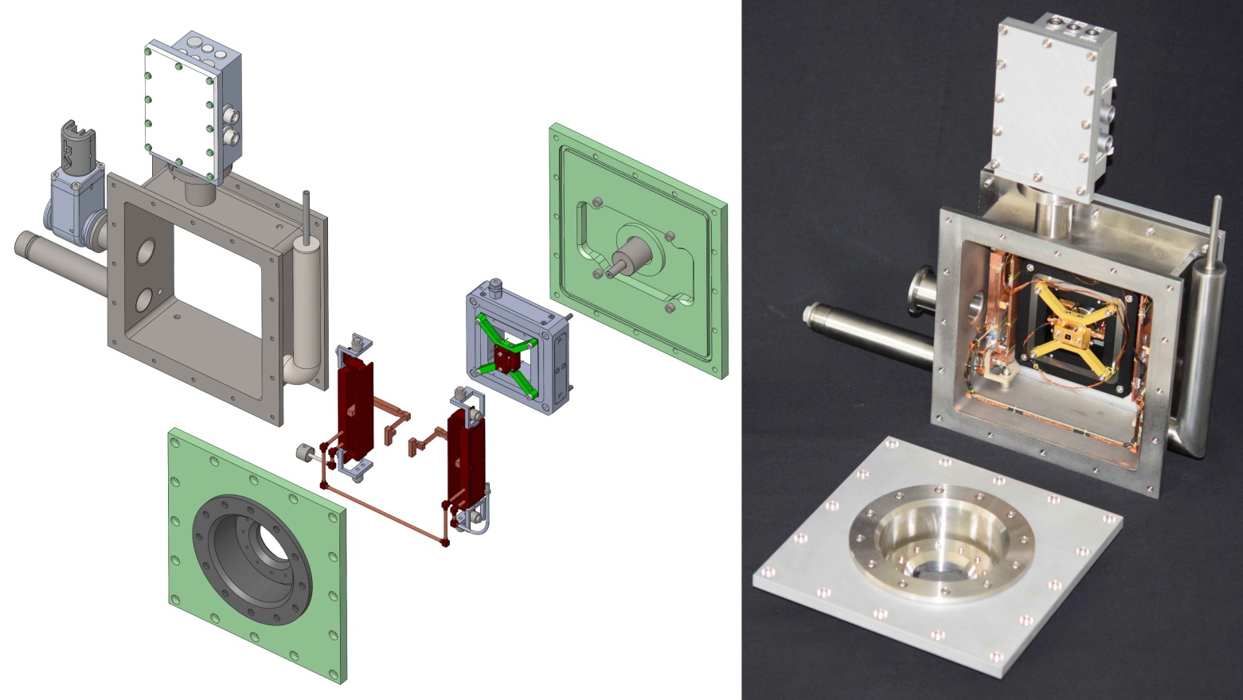
Nano scanning chamber design
XY Scanner: Piezo PI-733, range 100 um, resolution 5nm
Sample cooling by LN2 + braids
Sample support for SiN membranes
Modular construction: input window/piezo support,
Cryo unit, output window, connector box
200x200x100mm
14kg →
Huber 17cm

Slide 6
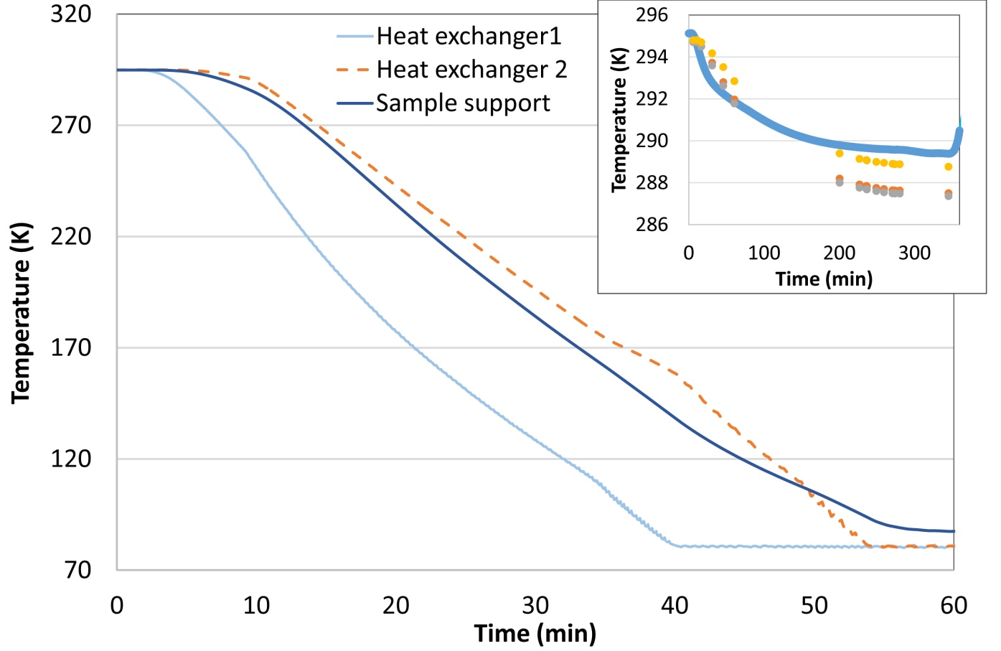
Cooldown testing
Cooldown time ~1 hour
Temperature drops → pressure drops a decade
Shields and piezo drop a few degrees in temperature

Slide 7
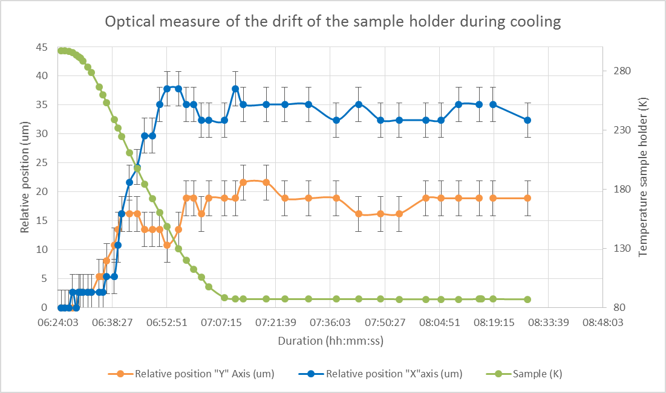
Cooldown testing
Position drift 10’s of microns during cooldown
BUT drift stops when cold

Slide 8
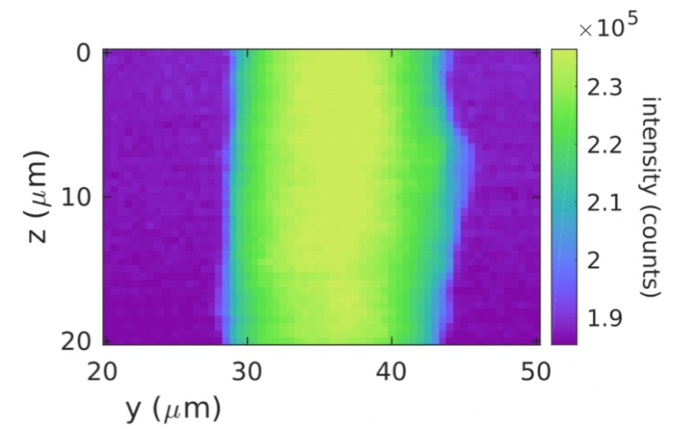
PARAMETERS AND DATA FROM 1ST XRAY TEST
Operating Temperature reached < 90 K
Operating Pressure reached < 10⁻⁶ mbar pumping continuously
Maximum piezo scan range for optical alignment: 100 x 100 μm
Typical scan size for x-ray experiments: 10x10 and 2x2 μm
X-ray beam size used: 100 x 300 nm (V x H)
Sample movements look at least as precise as with other devices
Sample change 8-12 hours including vacuum pumping
WAXS pattern from Al₂O₃ grains
Total intensity map of Kevlar fiber

Slide 9
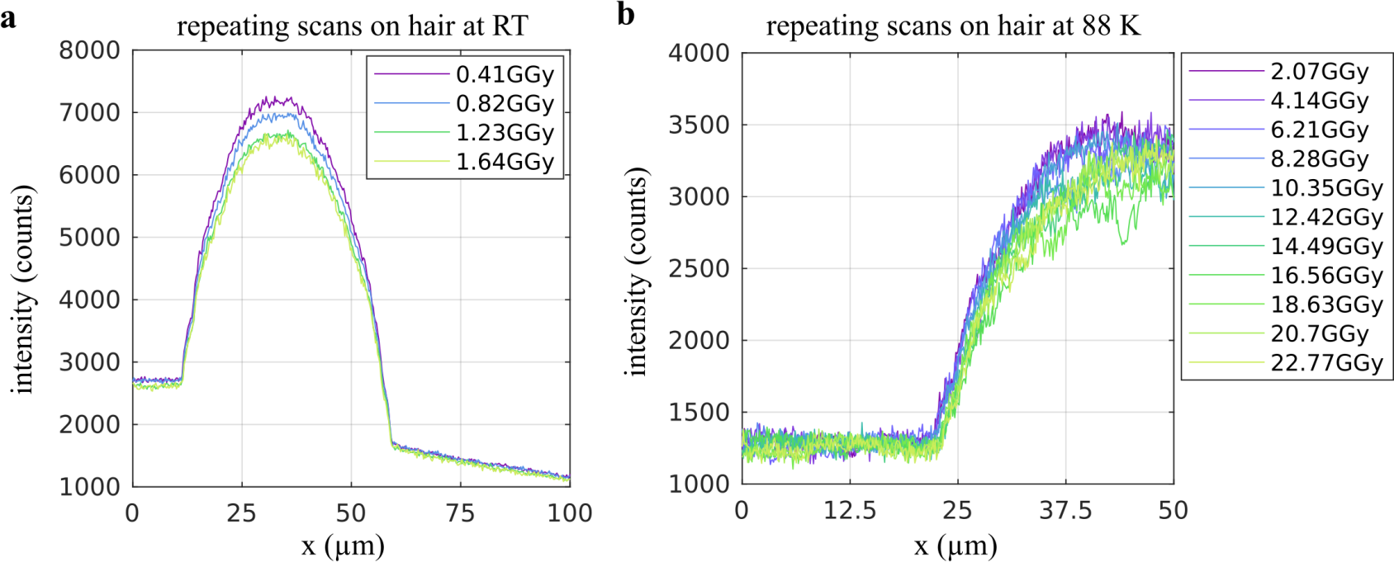
Radiation damage
Successive scans of a hair

Slide 10
Sample changer
BUDGET DEMAND 2019
Cryogenic sample transfer:
Sample holder copy of ID32
Changer has two sample positions for the old and new sample
Magnetic manipulator
On board LN2 for autonomy
50cm / 4kg
25mm / 10g
Load new sample in docking station
Close and pump vacuum
Place sample in parking position
Connect to chamber
Pump intermediate space
Remove old sample + park
Pick new sample from parking
Place new sample
Remove sample changer

Slide 11
Chamber for ID16
Piezo scan chamber for ID16:
Design is done, chamber not built
Needs another sample support, braids and window cap
Beam in and out through front window
Sample support reversed
Front window for fluorescence
Rear window for transmission
Changeover in < 1 day
Sample changer to fit the two

Slide 12
conclusions
The concept works: nano scale movements, cryoprotection
Small improvements: piezo cabling, input window, …
It needs the sample changer for efficient operation
Suitable for other beamlines
Acknowledgements:
ID13: Lionel Lardière, Martin Rosenthal, Manfred Burghammer
Göttingen: Jan-David Nicolas, Tim Salditt
PSCM: Manon Chesneau, Pierre Lloria, Diego Pontoni

